Slide 1
Working with Forms and IFrames04
Session 4
(slot 6-7)

Slide 2
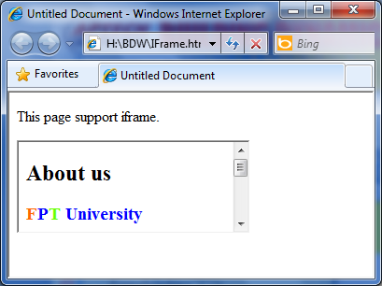
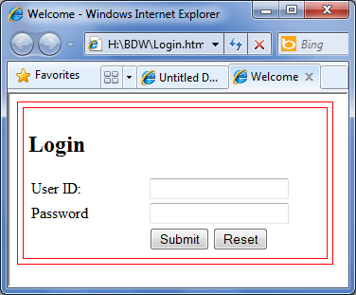
Contents
IFrames
Forms and Controls

Slide 3
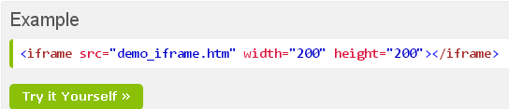
IFRAMES
An iframe is used to display a web page within a web page.
<iframe src=“url” target=“…” width=“…” height=“…”></iframe>

Slide 4
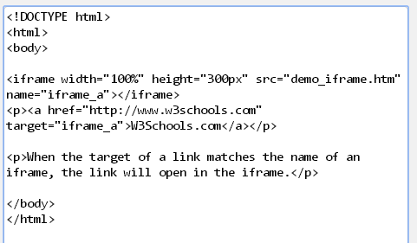

IFRAMES

Slide 5
FORMS AND CONTROLS
Explain HTML forms
Describe the basic elements
Explain the INPUT element
Explain the LABEL element
Explain the BUTTON element
Explain the SELECT and OPTION elements

Slide 6
Forms
An HTML form is a container that consists of various controls such as checkboxes, radio buttons, menus, …
For example, consider a Login form that allows you to specify the login name and password.

Slide 7
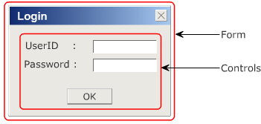
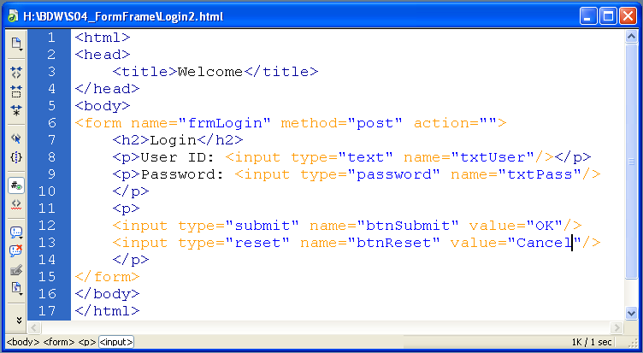
Forms

Slide 8
Forms
Attribute of Form
Attribute | Description
action | Specifies the URL where the form data will be submitted and processed.
method | Indicates an HTTP method that specifies how the data of the form is send to server. This attribute has two values namely: GET and POST.

Slide 9
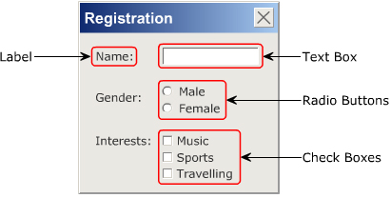
Basic Controls
Label
Text Box
Button
Check Box
Radio Button

Slide 10
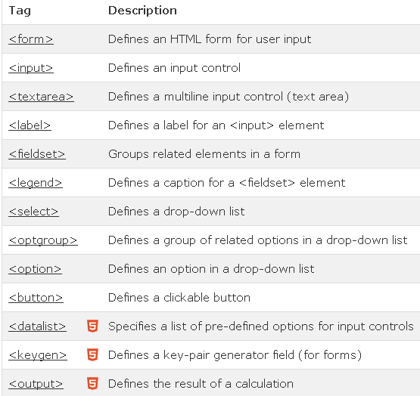
Form Elements

Slide 11
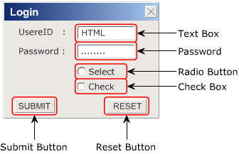
INPUT Element
A control allows you to accept different type of input from the user.
The different values that the type attribute can take care:
  Text for Text Box
  Password for Password
  Submit for the Submit button
  Reset for the Reset button
  Radio for Radio Button
  Checkbox for Check Boxes

Slide 12
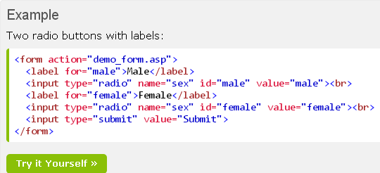
LABEL Element
A LABEL element creates a label control on a form.
You use the FOR attribute associates a label with another control.
The value of the FOR attribute must be the same as the value of the ID attribute of the associated control element.

Slide 13

BUTTON Element
A BUTTON element creates a button on a form.
The buttons created using the BUTTON element are similar to buttons created with INPUT element, however it’s offer richer functionalities.

Slide 14
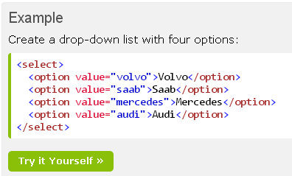
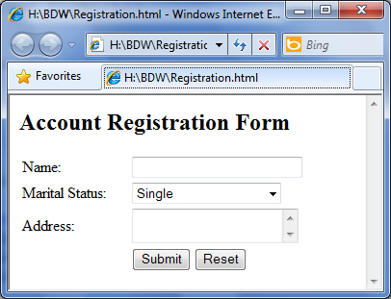
select Element
Menus are control that allow the user to select an option from a given set of options.
To create menu, you use SELECT element. The select element must have at least one OPTION element.
Menu that allows the user to select a single option or multiple options.

Slide 15
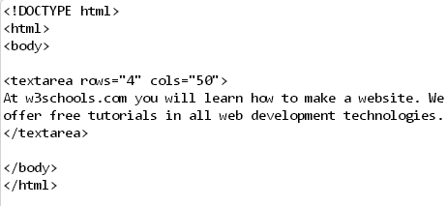

Textarea element
The <textarea> tag defines a multi-line text input control.
A text area can hold an unlimited number of characters, and the text renders in a fixed-width font (usually Courier).
The size of a text area can be specified by the cols and rows attributes, or even better; through CSS' height and width properties.

Slide 16
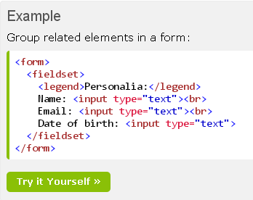
Fieldset, legend element
The <fieldset> tag is used to group related elements in a form.
The <fieldset> tag draws a box around the related elements.

Slide 17
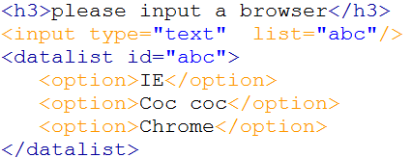
Datalist element
specifies a list of pre-defined options for an <input> element.
is used to provide an "autocomplete" feature on <input> elements.

Slide 18
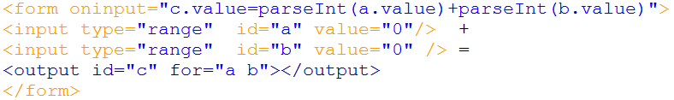
Output element
The <output> tag represents the result of a calculation (like one performed by a script).
not support in IE

Slide 19
Summary
A form is selection of an HTML document that contains special elements called as controls.
Control are used to accept input from user and provide some interaction
The <FORM> element is used to create the region on the page that will be treated as a form.
The <INPUT> element defines the type and appearance of the control to be displayed on the form

Slide 20
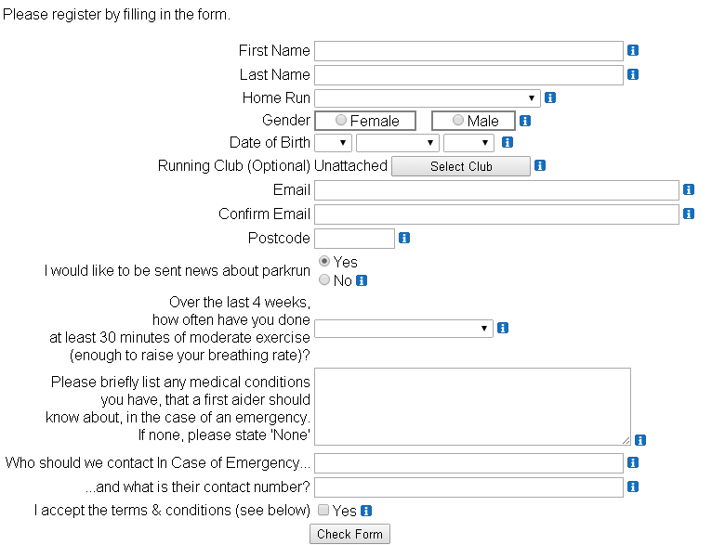
exercises

Slide 21

Exercises
Click here
To Open this form in iframe

